Slide 1
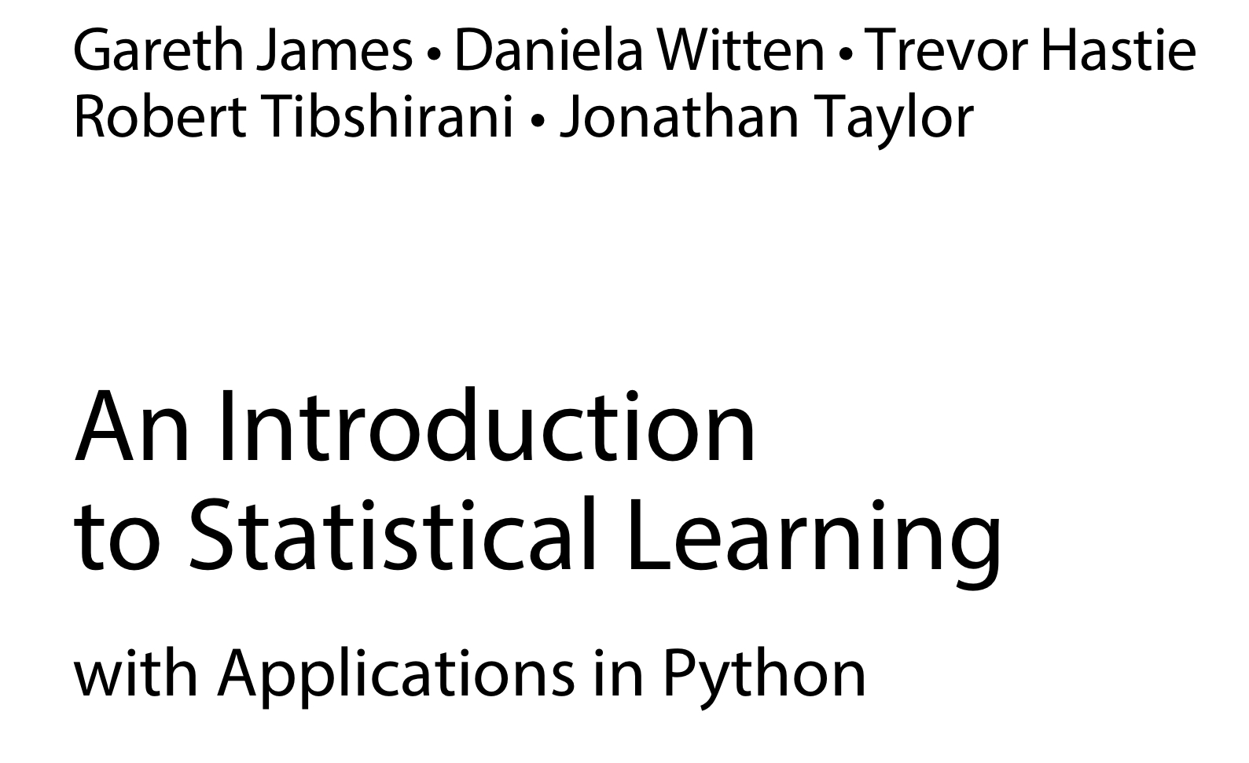
Introduction to Statistical Learning Book Highlights
by Seher Özçelik, PhD.
sozcelik19@ku.edu.tr
Intro

Slide 2
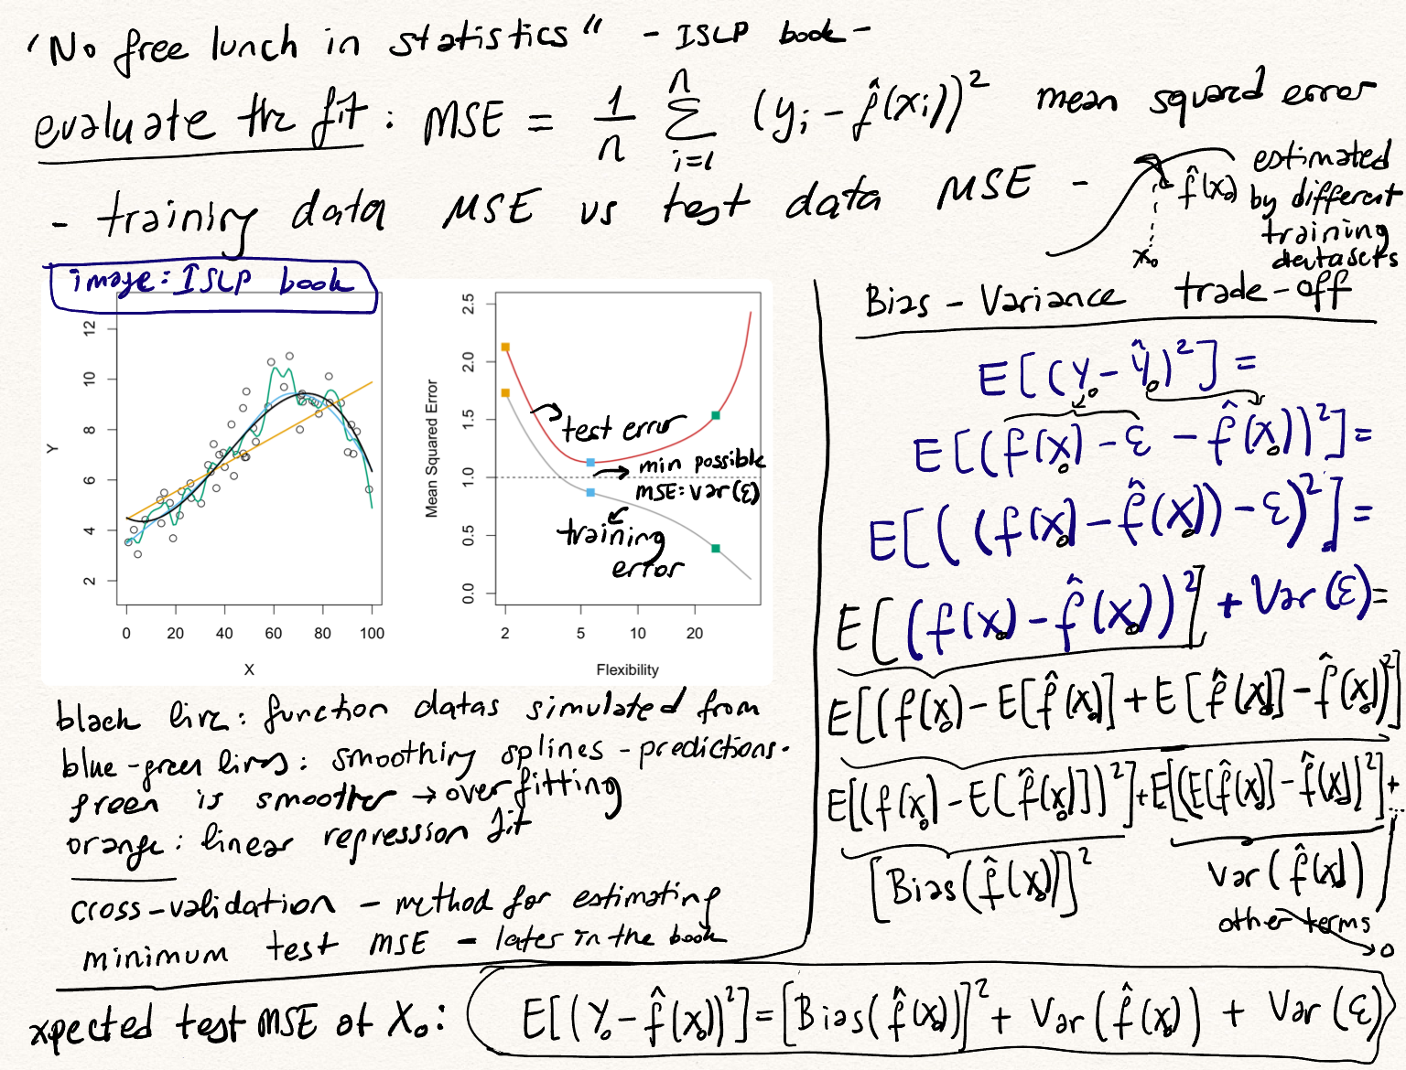

Slide 3
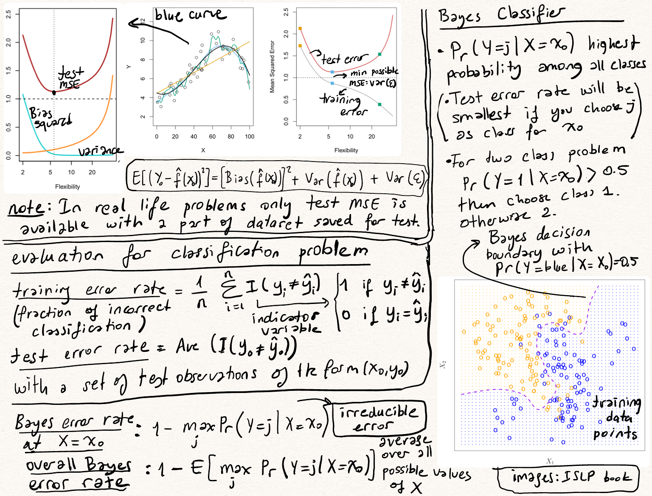

Slide 4
